Slide 1
Microsoft Passport and Windows Hello Developer’s Guide to Windows 10 Build 10586 SDK Update
Andy Wigley Rajen Kishna
@andy_wigley @rajen_k

Slide 2
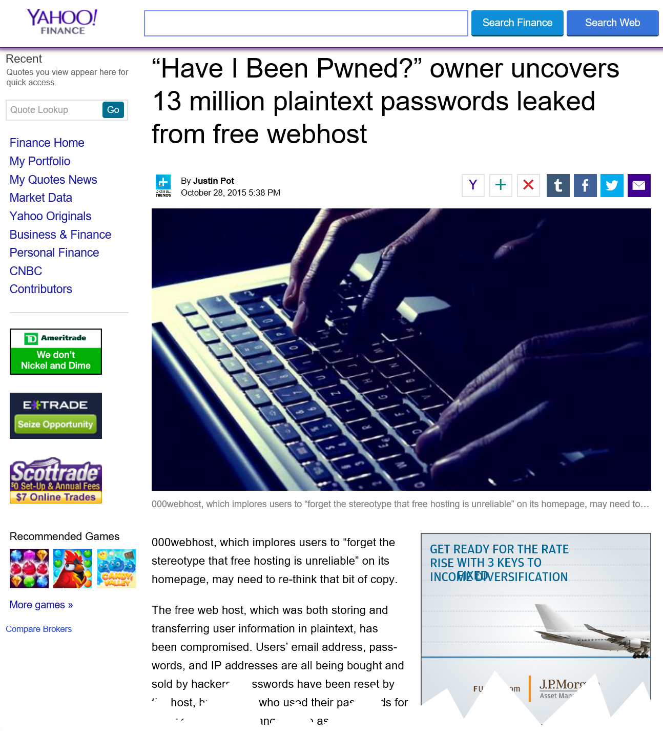

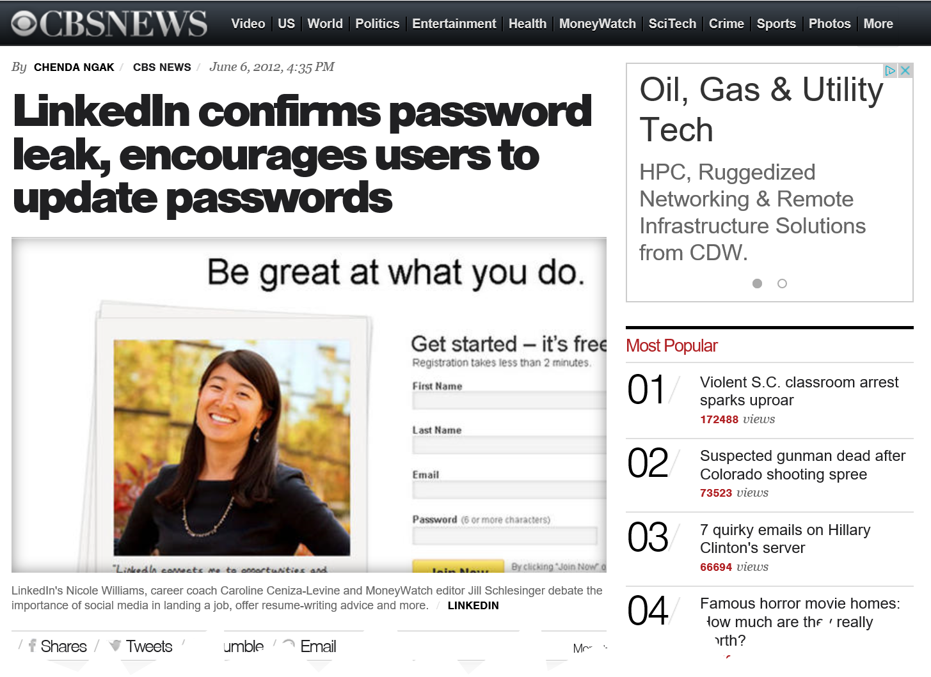
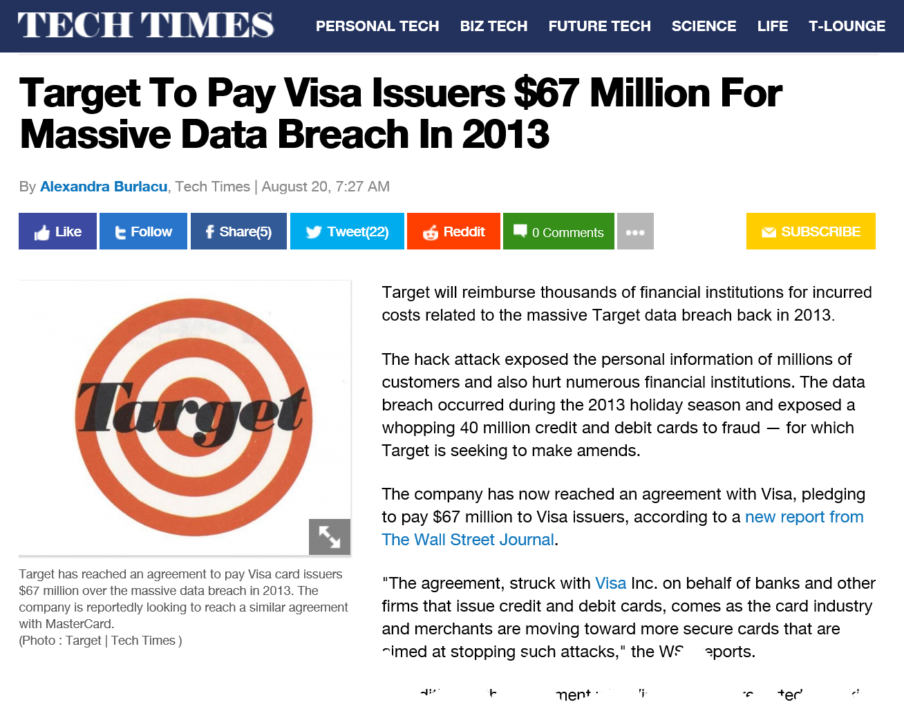
Age of cybercrime

Slide 3
Password authentication
Username + password
User provides username + password
Server checks username + password
Server returns authentication status
Data exchange begins
Challenges
Credential theft through phishing
Credential reuse
Password complexity/expiration
Password-reset mechanisms
User password carelessness
Password management for IT
username
********

Slide 4
Two-factor authentication
Authentication
Secure authentication for users
Password management is unwanted overhead
Data-in-flight security
Secure data transfer over networks
Services exposed over Internet
Data-at-rest security
Secure data storage
Enterprise data protection
Benefits
Combining “something you know” with “something you have”
Mitigates most challenges with password authentication
Challenges
Complexity of implementation (incl. cost)
Difficulty of use for end-users
username
********

Slide 5
“Let’s make the internet safer by getting rid of passwords”

Slide 6
Introducing Microsoft Passport and Windows Hello

Slide 7

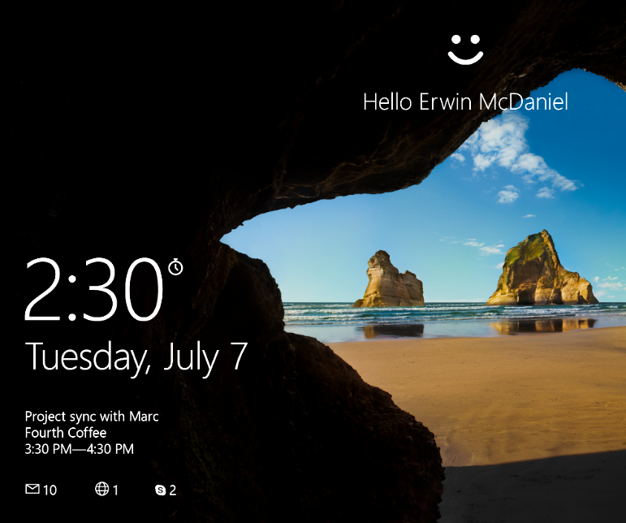

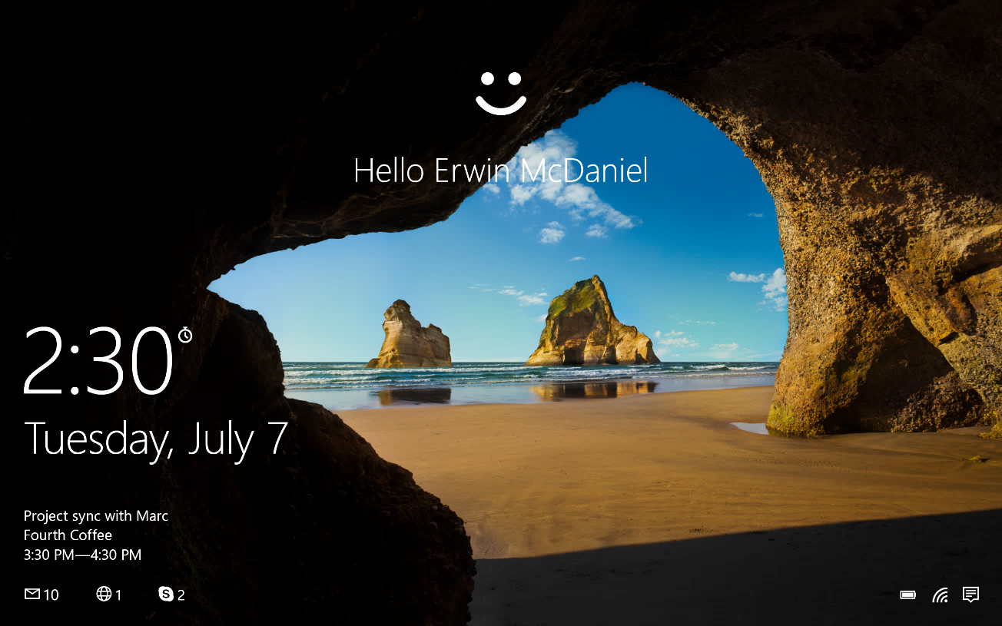

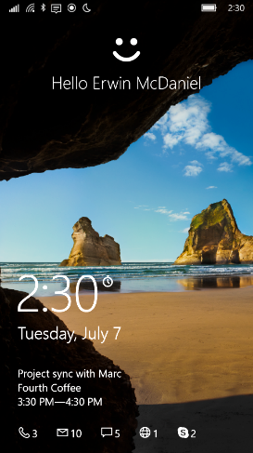
Microsoft Passport & Windows Hello
Convenient multi-factor authentication
Microsoft Passport
Enterprise-grade two-factor authentication
Device + biometric or PIN
Windows Hello
End-user experience for authentication
Biometric framework supporting face, iris and fingerprint

Slide 8
What is Microsoft Passport for Work?
Designed for integration with your existing and future directory infrastructure and device deployments
Azure Active Directory and on-premises Active Directory
Single sign-on with PIN/Windows Hello
Group Policy Management

Slide 9
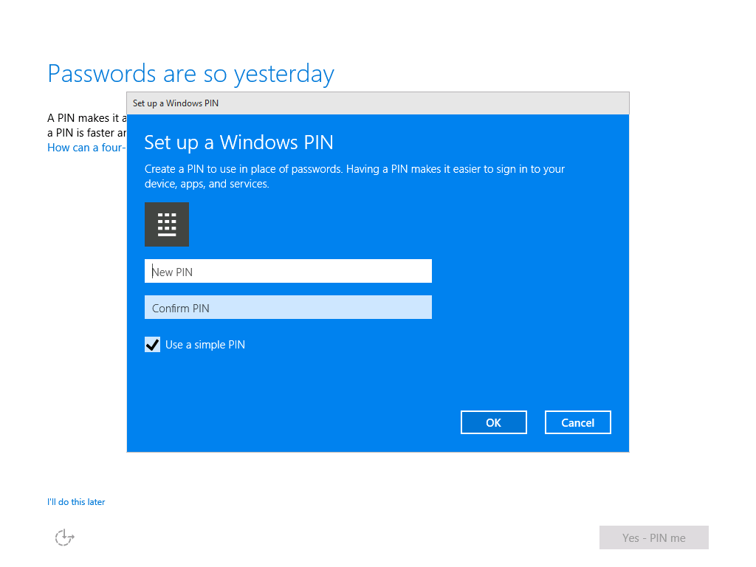
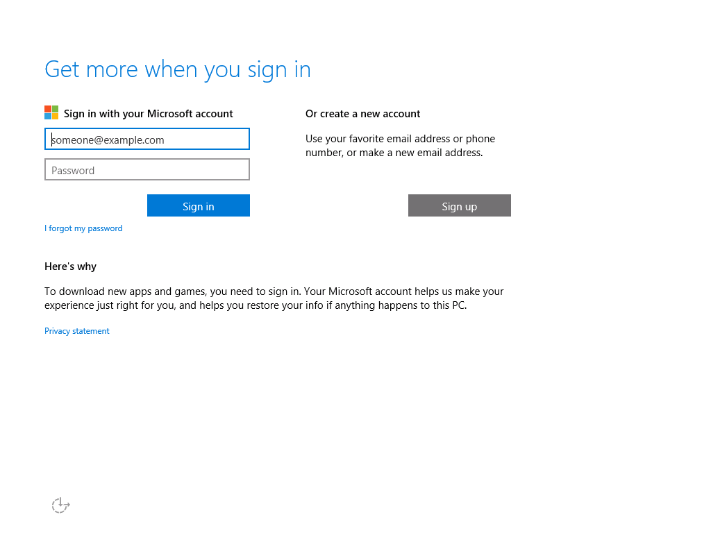
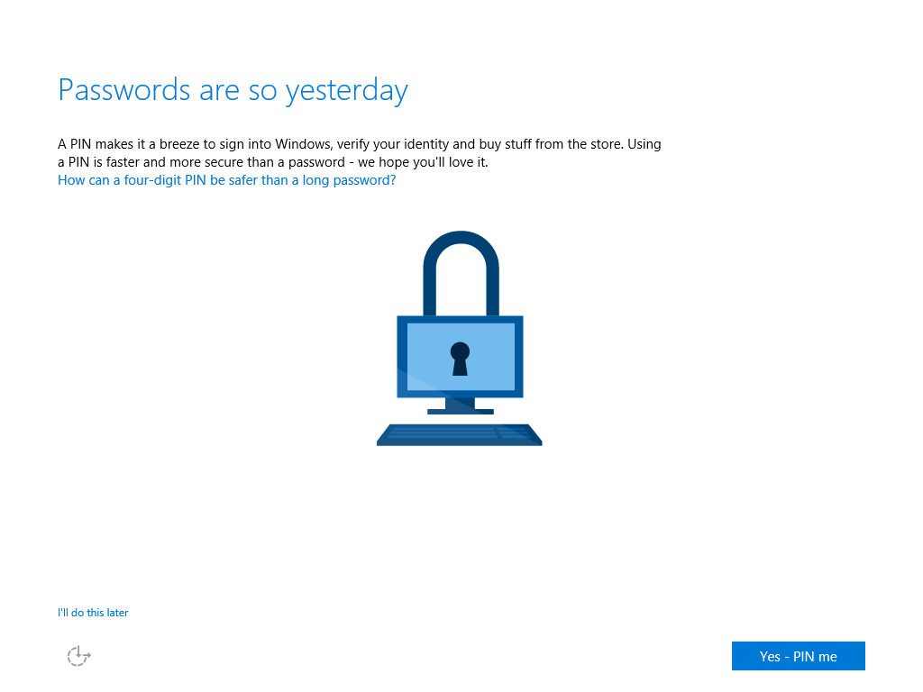
Microsoft Passport enrollment in Windows 10
During out-of-box-experience (OOBE) setup

Slide 10
Demo: How to setup your PIN

Slide 11
Implementing Microsoft Passport and Windows Hello in your Universal Windows Platform app

Slide 12
Steps to enable Microsoft Passport in your app
Enrol or sign-up a new user and device
Authenticate user with Microsoft Passport (PIN) or Windows Hello (biometrics)
Provide mechanism to disable devices and users

Slide 13
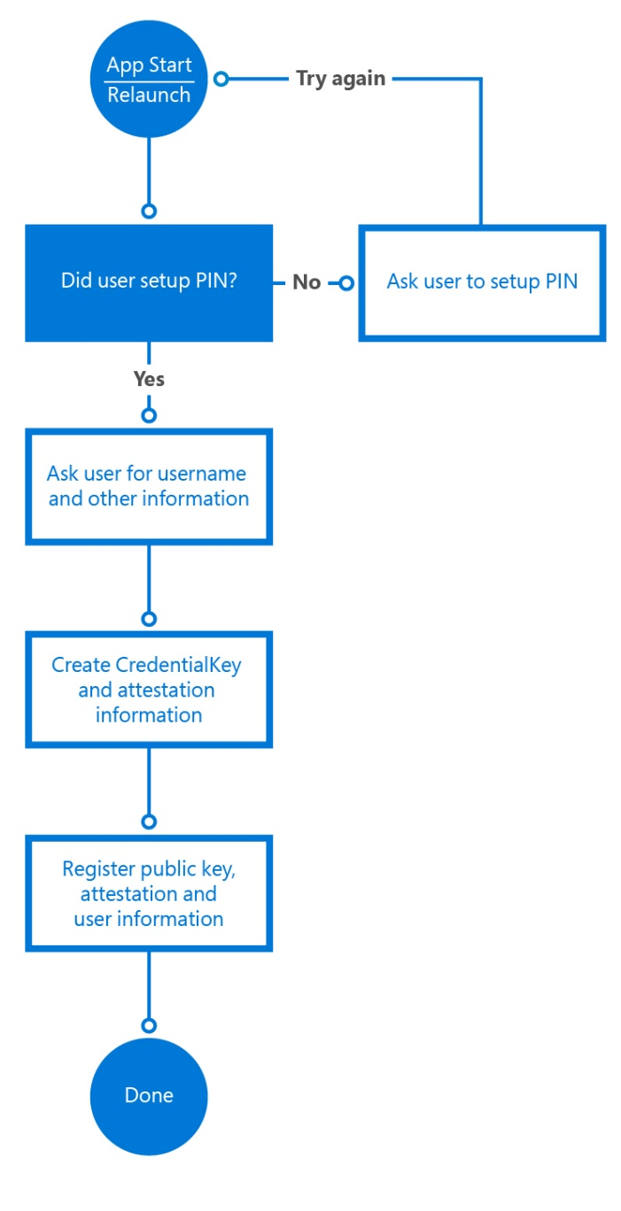
Enabling Microsoft Passport in your app
Validate if the user has set up a PIN, and optionally Windows Hello, on their device KeyCredentialManager.IsSupportedAsync
Create CredentialKey and attestation KeyCredentialManager.RequestCreateAsync
Register public key, attestation and user information with the server for validation on login

Slide 14
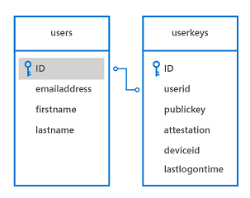
Storing public keys for the user
You might need to change your server-side database to store multiple keys

Slide 15
Demo: Step 1, enroll new device and user

Slide 16
Microsoft Passport authentication
Application Start and request data from backend service
Server needs the user to authenticate first and sends a challenge
App needs to sign the challenge with the private key. var signResult = await userKey.RequestSignAsync(message);
User is prompted for PIN or Biometric gesture
Challenge is signed and send back to the server
Server validates the signature with the public key from the user already stored
If valid, authorizes the user and returns the requested data
3
7
4
5
1

Slide 17
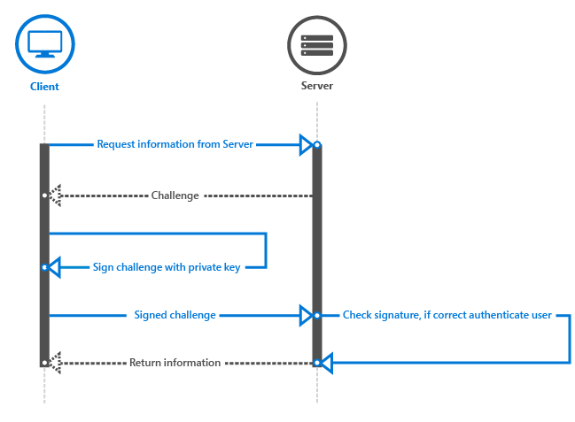
High level overview authentication process

Slide 18
Demo: Authenticate user against backend

Slide 19
Other things to consider
Un-enrol users and devices
Independently provide a mechanism for users to un-enrol specific devices
Enrol extra devices
Adding additional devices for a particular user
Secure challenge/response
Prevent replays
Proprietary to your implementation

Slide 20
Summary
Convenient for the user
User only has to remember PIN or can use Windows Hello
No secrets are stored on servers -> Two factor authentication with asymmetric keys
More information on https://dev.windows.com/enterprise
Developer whitepaper on Microsoft Passport and Windows Hello
Sample available on GitHub on December 16

